Slide 1
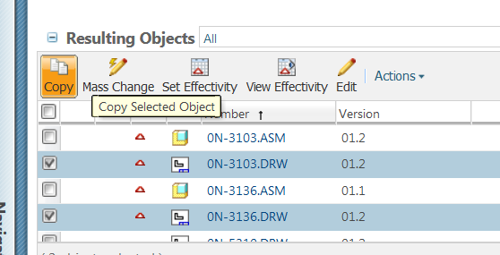
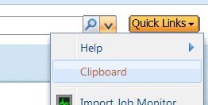
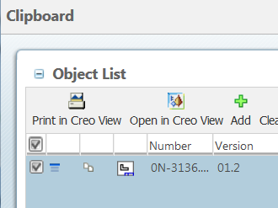
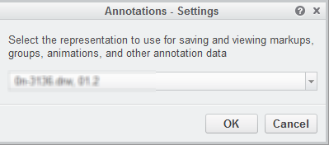
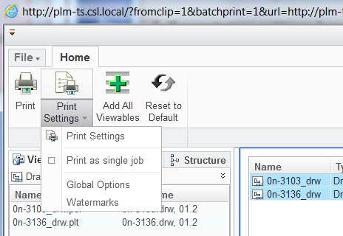
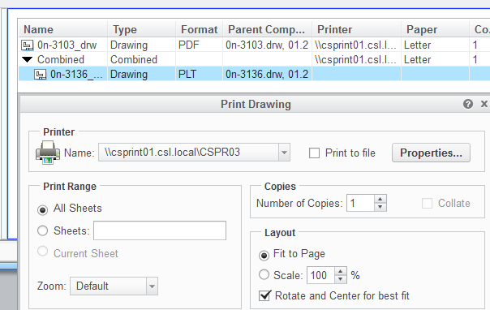
How to Batch Print in Windchill
From any Windchill tables. Select the drawing to be batch printed by checking the check box.
Click Copy.
b
1
a
c. Click Quick Links and Clipboard.
c
2
In the Clipboard:
d. Check box to Select all.
e. Click Print in Creo View.
3
e
d
4
In the move dialog:
f. If annotation settings box open click ok.
f
In CreoView:
g. Using ctrl + shift select all documents.
h. Click print settings > print as a single job.
5
h
g
i. under the “Combined” select all documents.
-Click print settings > print settings .
j. In the Zoom section select default.
- Adjust all parameters as you wish.
- Click OK then click Print.
i
6
j

